Slide 1
Forecasting Currency Exchange Trend
My Case Study is United States Dollar (USD) vs Canadian Dollar (CAD)
Master’s Thesis
By: Akubue Simon C
On: 26-Nov-2024

Slide 2
Motivation
Majority of the Forex traders lose their money due to inadequate knowledge on the dynamics of the market forces. 98% of the times, market forces is determined by the Macroeconomics news from the countries around the world.
Mitigating against this high rate of losses formed the basis of my research dream on “Forecasting Forex Exchange Trend”

Slide 3
Content
Pre-Amble
Data Sources
Statistical
Technical
Macroeconomics
Algorithms
Flow Diagram
Models Comparison
Visualization
Result
Recommended Model
Future Plans

Slide 4
Pre-Amble
The foreign exchange (forex) market stands as one of the most dynamic and influential financial markets globally, facilitating the exchange of currencies and shaping international trade and investment. Among the myriad currency pairs traded in this market, the USD/CAD pair occupies a significant position due to its prominence in North American trade and its influence on the economies of the United States and Canada.

Slide 5
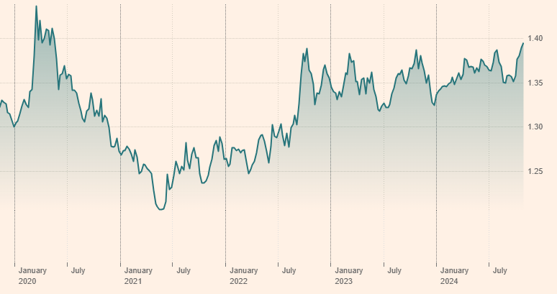
Last five years data on USD/CAD
https://markets.ft.com/data/currencies/tearsheet/summary?s=USDCAD

Slide 6
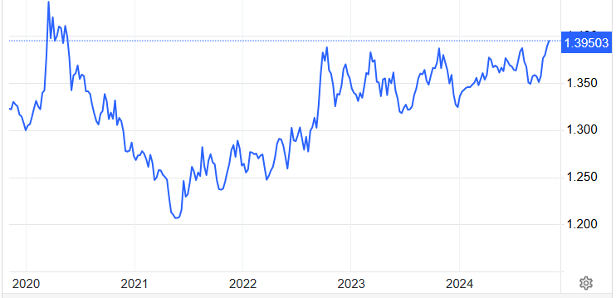
Last fifty years data on USD/CAD
https://tradingeconomics.com/canada/currency

Slide 7
Data Sources
FRED
Macroeconomics data
Split
Scale
Train/Test
Evaluate
Forecast
Forex Market
DataFrame
Statistical data
Technical data

Slide 8
Data Source {Statistical}
My Data Set is taken from either of these two sources:
Tick Data Suite (TDS) ➔ From year 2003 to May-2024 {with over 5,500 records}
(b) Investing.Com ➔ From 1982 to May-2024 {with over 11,100 records}
The data in either of these two cases is maintained on a daily bases.

Slide 9
Data Source {Macroeconomics}
The following Macroeconomics data played a strong role in my model. They were sourced from the Federal Reserve Economic Data (FRED)’s(https://fred.stlouisfed.org/) database through an API that was exposed as XMLs.
Consumer Price Index (CPI) of USA Consumer Price Index (CPI) of Canada
The Interest Rates of USA The Interest Rates of Canada
Imports of USA Imports of Canada
Exports of USA Exports of Canada
Un-Employment Rates of USA Un-Employment Rates of Canada

Slide 10
Data Source {Technical}
The following technical indicators were integrated:
RSI – Relative Strength Index
This is a momentum indicator that measures the magnitude of recent price changes to analyze overbought or oversold conditions
(b) SMA - Simple Moving Average
This is the average price over the specified period. It is calculated by adding up the last "X" period's closing prices and then dividing that number by of Xs

Slide 11
Data Source {…..Technical}
(c) EMA – Exponential Moving Average
This is a type of moving average that gives more weight to recent data points compared to older data points. It is calculated by applying a smoothing factor to the previous EMA value and the current price.
(d) MACD - Moving Average Convergence Divergence
This is a popular technical analysis indicator used to identify trend reversals and momentum changes in financial markets, including stocks, currencies, and commodities. It consists of three components: the MACD line, the signal line, and the histogram.

Slide 12
Algorithms
I am comparing many models like:
I am considered the following models for my forecasting:
XGBoost model
Lasso Regression model
Ridge Regression model
Linear Regression model
AdaBoost Regression model
Random Forest Regressor model
Bayesian Ridge Regression model
Support Vector Regression (SVR) model

Slide 13
Flow Diagram
Data Source 01
FRED
Split & Scale the Data
Macroeconomics data
Investing.Com
Train the Model
Source
DataFrame
Evaluate the Model
Data Source 02
Tick Data Suite (TDS)
Predict the Future

Slide 14
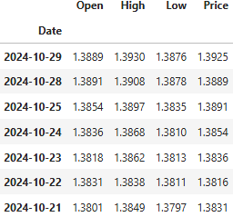
Statistical Data {Without Label}

Slide 15
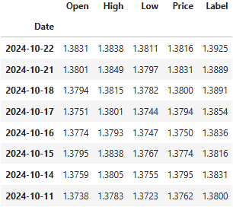
Statistical Data {with Label}

Slide 16
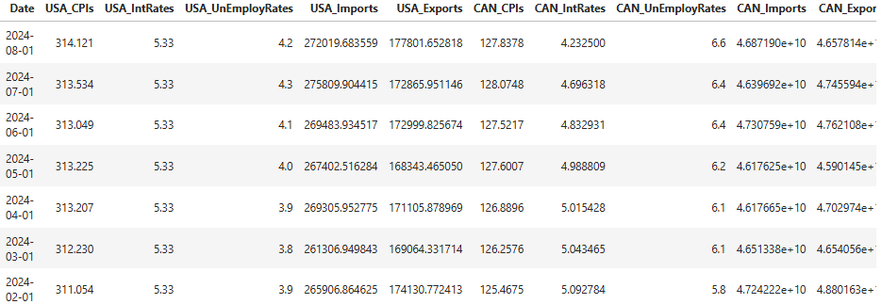
Macroeconomic Data {Raw}
Source = 'https://fred.stlouisfed.org/'

Slide 17
Macroeconomic Data
Dates
Index Values
01.11.2024
134.26
No of Business Days = 23
Diff = 0.019395
01.10.2024
124.0
Incremental Value = Diff/No of Business Days

Slide 18
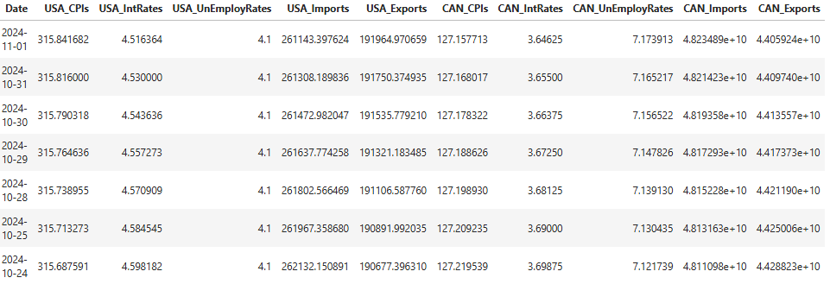
Macroeconomic Data {Calibrated/Filled}

Slide 19
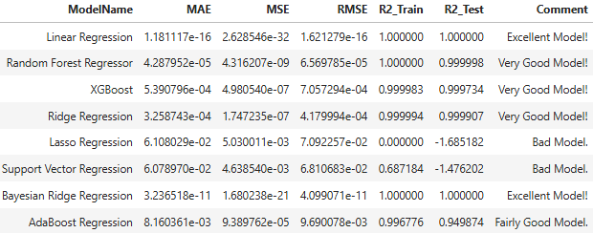
Models Comparison
85% Train – 15% Test Splitting

Slide 20
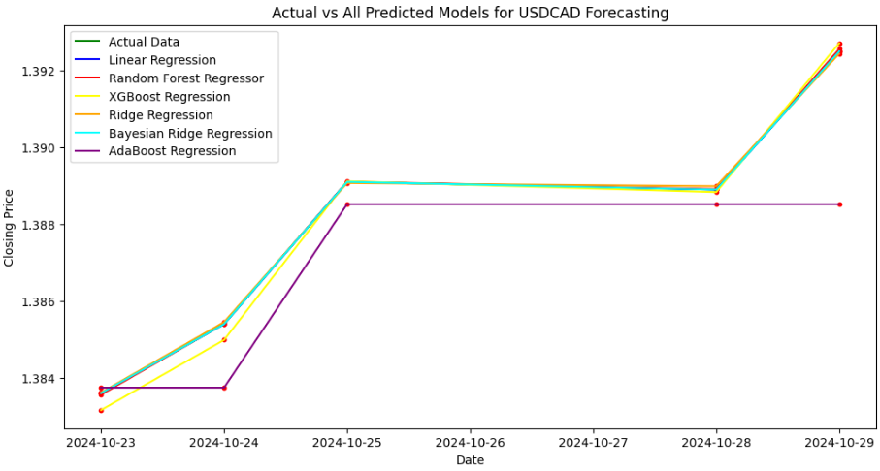
Visualization (85% - 15%)

Slide 21
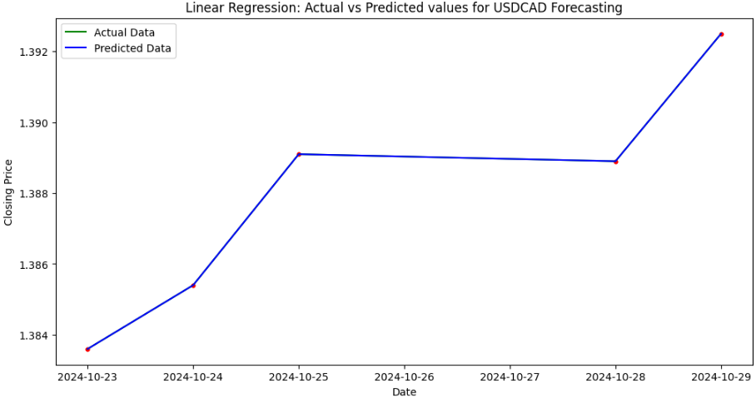
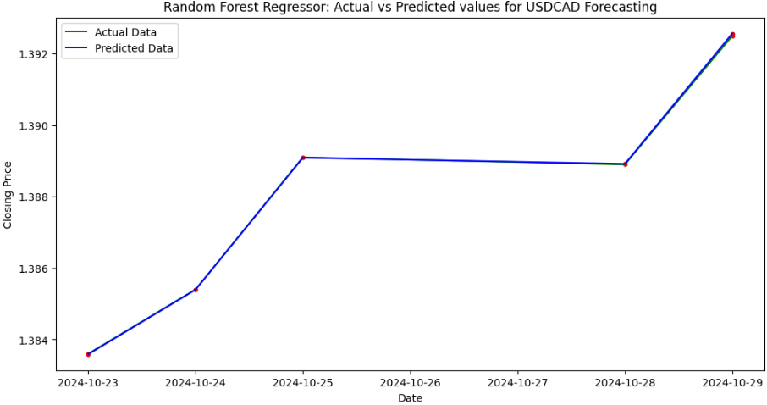
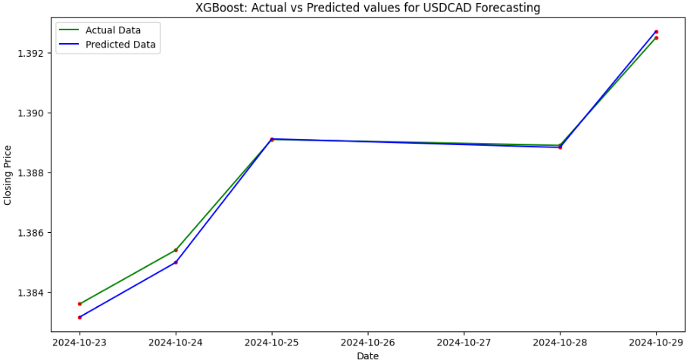
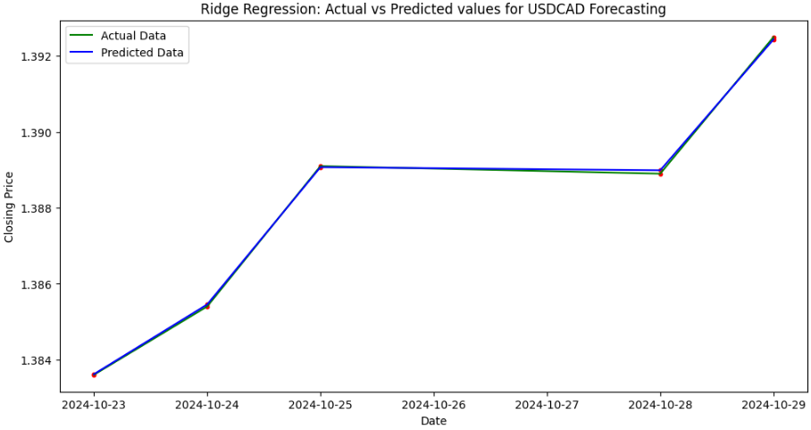
Visualization (85% - 15%)

Slide 22
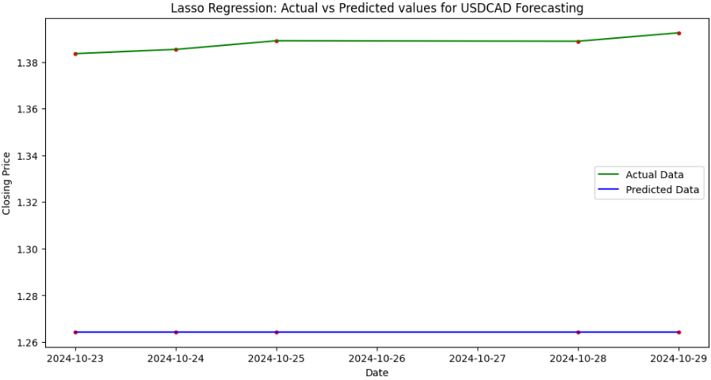
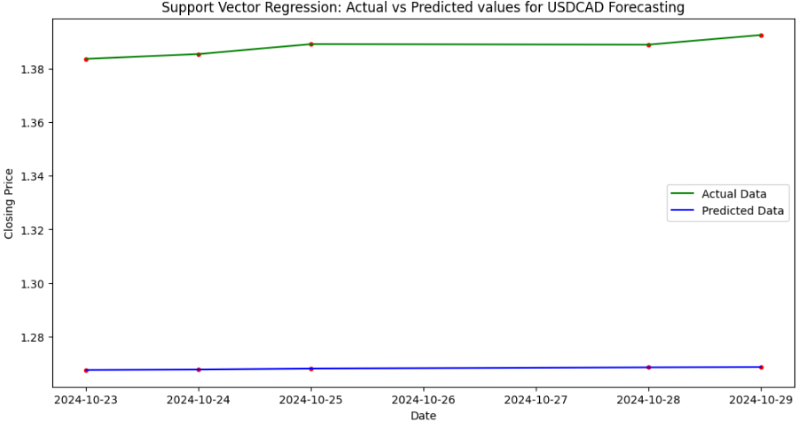
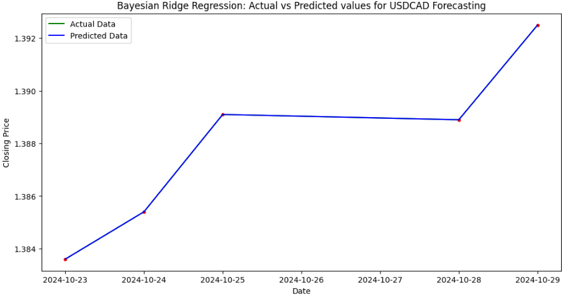
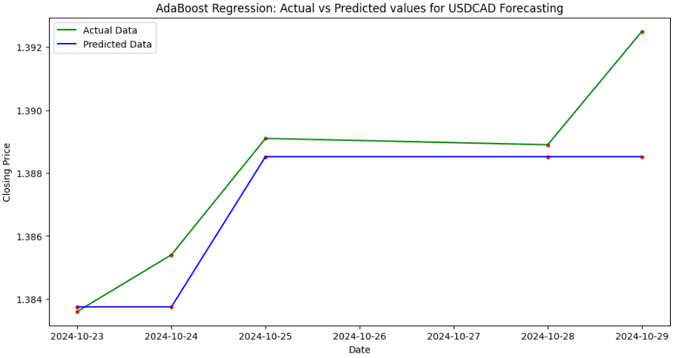
Visualization (85% - 15%)

Slide 23
Result
From the above analysis, on reviewing the MAE and MSE, and RMSE values from all the models considered, it is apparently clear that “Linear Regression”, “Random Forest Regressor (RFR)” and “Ridge Regression” displayed wonderful results. However, I will be relying more on “Random Forest Regressor (RFR)” due to its robustness about accepting as many features as I wish.
RFR model is exposed to un-exhaustible features. This makes is possible to incorporate lots of Indicators which of course is the bedrock of Technical (Non-Fundamental) analysis in predicting Forex trends.

Slide 24
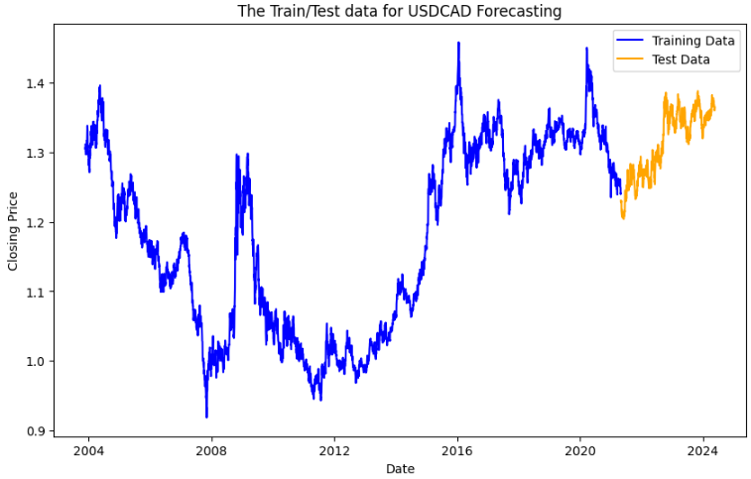
Raw data from TDS

Slide 25
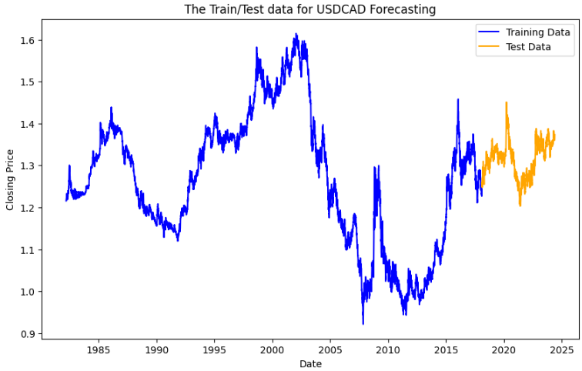
Raw data from Investing.Com

Slide 26
Random Forest Regressor (RFR)
Random Forest Regressor (RFR) is a supervised learning algorithm belonging to the ensemble learning family, specifically the random forest method, used for regression tasks. It's an extension of the Random Forest algorithm for classification.
Random Forest Regressor is known for its robustness, scalability, and ability to handle high-dimensional data with a large number of features. It often performs well across a wide range of regression problems and is less prone to overfitting compared to individual decision trees.

Slide 27
…Flexibility and Robustness of RFR
This model offered me the opportunity of adding as many features as I can in order to improve on my Predictions.
Here I employed the standard indicators like:
RSI (Relative Strength Index)
SMA (Simple Moving Average)
EMA (Exponential Moving Average)
MACD (Moving Average Convergence/Divergence)
I can add as many more indicators in order to strengthen the quality of my predictions.

Slide 28
My Codes (Interesting Parts)

Slide 29
Future Plans
I will also explore alternative source where I can access the Macroeconomics indices maintained at bi-Annual, Quarterly, or Monthly levels.
I plan to improve on my model by adding more Statistical and Technical features.
I will explore a way of automatically accessing the Statistical data from a source like Tick Data Suite(TDS) whose data is as close as the live data.

Slide 30
Thank you

